Slide 1







ModelFLOWs
APP
MODAL DECOMPOSITION
DEEP LEARNING
Pattern detection
Reconstruction
Prediction
Pattern detection
Reconstruction
Prediction
HOSVD
Data Repairing
HODMD
Autoencoders
Superresolution
Full DL
HODMD
Superresolution
Hybrid

Slide 2
Motivation
ModelFLOWs
APP
MODAL DECOMPOSITION
DEEP LEARNING
Pattern detection
Reconstruction
Prediction
Pattern detection
Reconstruction
Prediction
HOSVD
Data Repairing
HODMD
Autoencoders
Superresolution
Full DL
HODMD
Superresolution
Hybrid

Slide 3
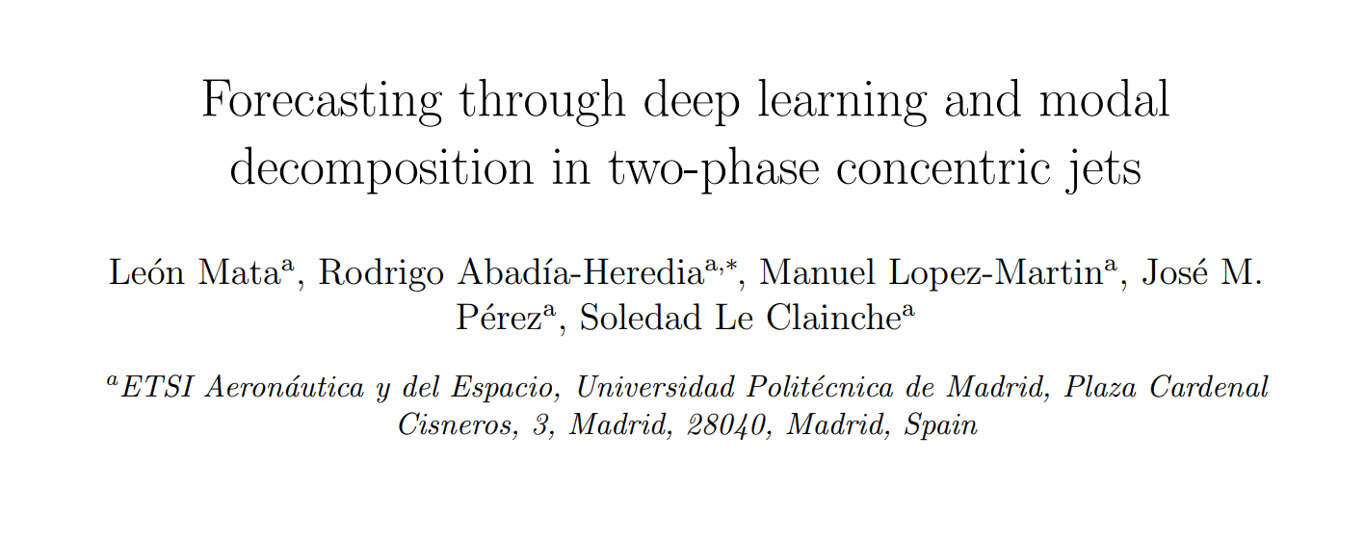
Motivation
Full DL
Forecasting through deep learning and modal decomposition in two-phase concentric jets
https://doi.org/10.48550/arXiv.2212.12731

Slide 4
Motivation
Full DL
Forecasting through deep learning and modal decomposition in two-phase concentric jets
https://doi.org/10.48550/arXiv.2212.12731

Slide 5
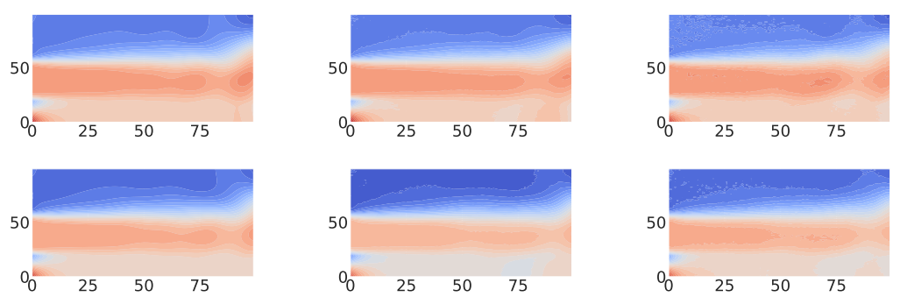
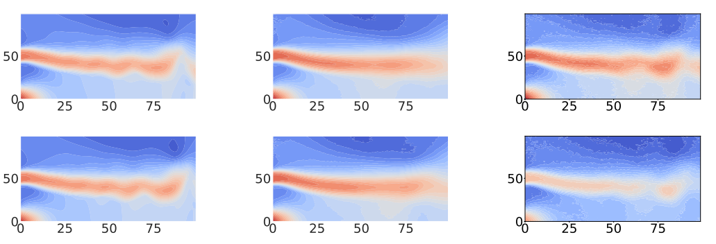
Methodology
Motivation
Full DL
Forecasting through deep learning and modal decomposition in two-phase concentric jets
In this work we proposed two forecasting models based entirely on deep learning.
In contrast to the other published works (HybridDL) in this case the data sets are directly pass into the models with no previous preprocess like SVD.
https://doi.org/10.48550/arXiv.2212.12731

Slide 6
Methodology
Full DL
10 previous samples
The 2 future samples
RNN model
CNN model
The 2 future samples

Slide 7
Database & Data preparation
Methodology
Full DL
RNN Model
CNN Model

Slide 8
Database & Data preparation
Full DL
Both models RNN and CNN have been developed to receive as input two data sets:
Training data set
Testing data set

Slide 9
Database & Data preparation
Full DL
Both models RNN and CNN have been developed to receive as input two data sets:
Training data set
Testing data set
Spatial dimensions (2D spatial grid)
Snapshots Tensor = $\{N_{v}, N_{x}, N_{y}, N_{t}\}$
Variables
Temporal dimensions

Slide 10
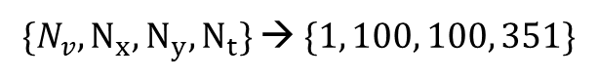
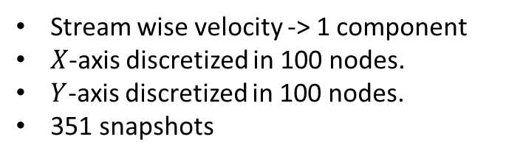
Calibration
Database & Data preparation
Full DL
Spatial dimensions (2D spatial grid)
Snapshots Tensor = $\{N_{v}, N_{x}, N_{y}, N_{t}\}$
Variables
Temporal dimensions
One of the data sets used in our paper:
Stream wise velocity -> 1 component
$X$-axis discretized in 100 nodes.
$Y$-axis discretized in 100 nodes.
351 snapshots
100 nodes
100 nodes
$\{N_{v}, N_{x}, N_{y}, N_{t}\}$→ $\{1, 100, 100, 351\}$

Slide 11
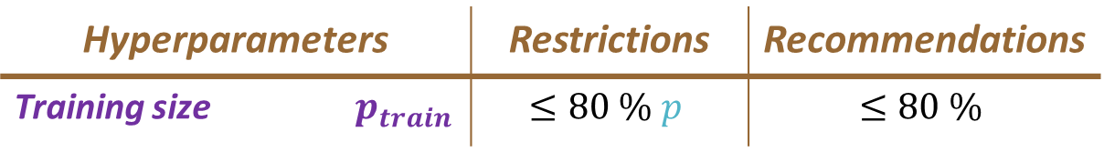
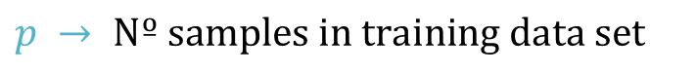
Calibration
Full DL
RNN Model
Hyperparameters |  | Restrictions | Recommendations
Training size | $$p_{train}$$ | $$≤80 \% p$$ | $$≤80 \%$$
CNN Model
$$p → Nº samples in training data set$$

Slide 12
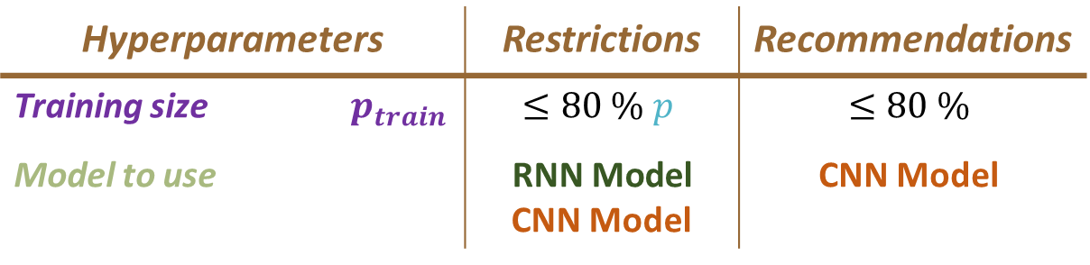
Calibration
Full DL
RNN Model
Hyperparameters |  | Restrictions | Recommendations
Training size | $$p_{train}$$ | $$≤80 \% p$$ | $$≤80 \%$$
Model to use |  | $$\text{RNN} \text{Model}$$ CNN Model | CNN Model
CNN Model
$$p → Nº samples in training data set$$

Slide 13
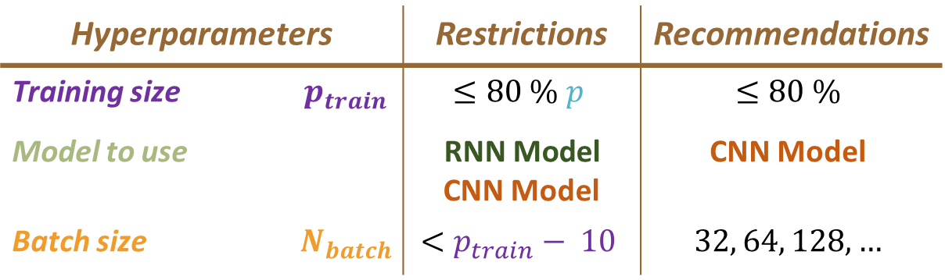
Calibration
Full DL
RNN Model
Hyperparameters |  | Restrictions | Recommendations
Training size | $$p_{train}$$ | $$≤80 \% p$$ | $$≤80 \%$$
Model to use |  | $$\text{RNN} \text{Model}$$ CNN Model | CNN Model
Batch size | $$N_{batch}$$ | $$<p_{train}− 10$$ | $$32, 64, 128, …$$
CNN Model
$$p → Nº samples in training data set$$

Slide 14
Calibration
Full DL
RNN Model
Hyperparameters |  | Restrictions | Recommendations
Training size | $$p_{train}$$ | $$≤80 \% p$$ | $$≤80 \%$$
Model to use |  | $$\text{RNN} \text{Model}$$ CNN Model | CNN Model
Batch size | $$N_{batch}$$ | $$<p_{train}− 10$$ | $$32, 64, 128, …$$
CNN Model
$$p → Nº samples in training data set$$
Batch size

Slide 15
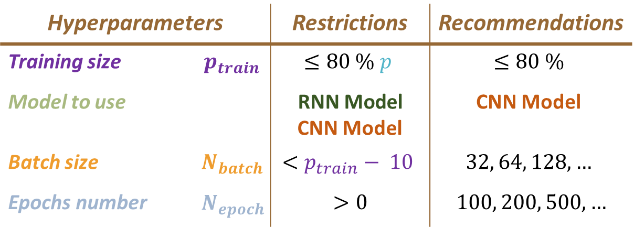
Results
Calibration
Full DL
RNN Model
Hyperparameters |  | Restrictions | Recommendations
Training size | $$p_{train}$$ | $$≤80 \% p$$ | $$≤80 \%$$
Model to use |  | $$\text{RNN} \text{Model}$$ CNN Model | CNN Model
Batch size | $$N_{batch}$$ | $$<p_{train}− 10$$ | $$32, 64, 128, …$$
Epochs number | $$N_{epoch}$$ | $$>0$$ | $$100, 200, 500,…$$
CNN Model
$$p → Nº samples in training data set$$
Batch size

Slide 16
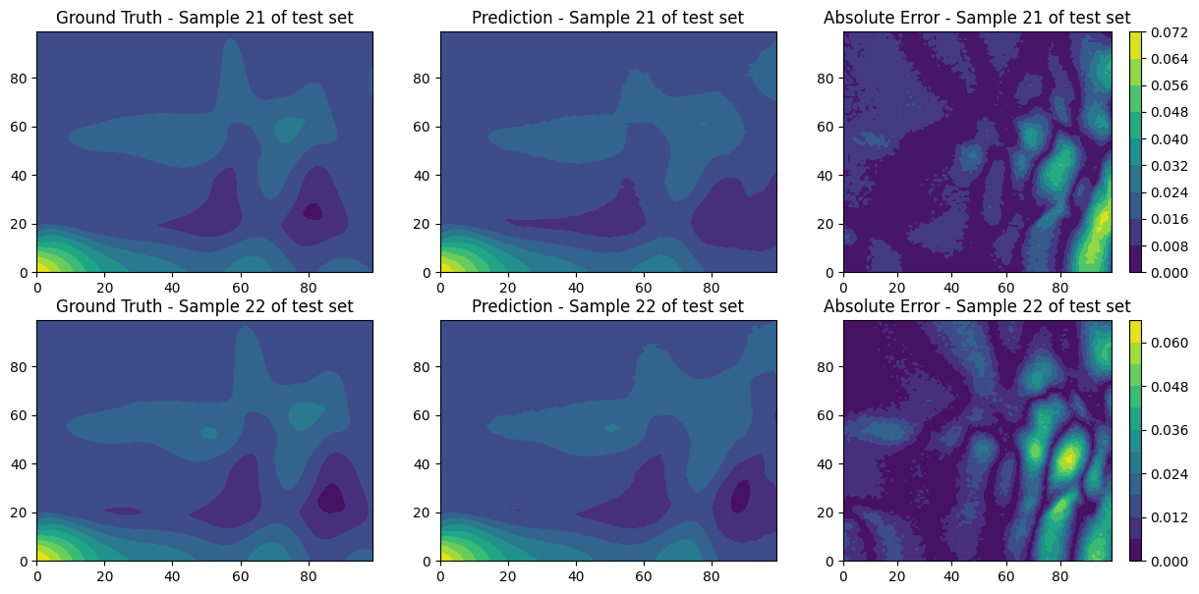
Results
Full DL
Both models return two data sets containing the two predictions that are obtained from the testing data set. It also allows to plot a qualitative comparison of the predictions and target.

Slide 17


Results
Full DL
Both models return two data sets containing the two predictions that are obtained from the testing data set. It also allows to plot a qualitative comparison of the predictions and target.
Click here for
more information

Slide 18

Thanks for watching! Visit us on: http://modelflows.es

